Slide 1
VEEVA Settings and VEEVA Messages
LEVEL - PRACTITIONER

Slide 2
Recap ...
In the previous Module - Online Application UI settings, you learnt to:
  Explore User Interface Settings
  Search Features
  Customize Home Tab Page Layout
  Manage Translations
And now ...

Slide 3

OBJECTIVE
After completing this chapter, you will learn to:
  Describe how VEEVA Settings are used
  Describe various fields of a VEEVA Message Record
  Create a custom VEEVA Message
  Identify the uses and best practices for VEEVA Marker Fields

Slide 4

OBJECTIVE
VEEVA provides some utilities that allows configuration of specific functionalities and components of VEEVA CRM that cannot be fully governed by Force.com configuration/customization
These utilities come in the form of Custom Settings, VEEVA Messages, Marker Fields and Section Signals
In this module, we describe how VEEVA Messages and VEEVA Settings and Marker Fields are used

Slide 5

Do You Know
Salesforce Custom Settings
  Custom settings are similar to custom objects and enable application developers to create custom sets of data, as well as create and associate custom data for an organization, profile, or specific user. Custom settings usually used for storing settings information to drive different application logic.
  All custom settings data is exposed in the application cache, which enables efficient access without the cost of repeated queries to the database
  There are 2 types of custom settings – List and Hierarchy

Slide 6
VEEVA Settings and VEEVA Messages
VEEVA Settings

Slide 7
What is VEEVA Settings?
VEEVA Settings is a custom setting which are similar to custom objects and provide the ability to define specific application behavior for an organization or profile
VEEVA Settings do not support user level settings
VEEVA Settings are used by the VEEVA CRM application to configure the behavior of various modules, enable/disable features and add/remove buttons
VEEVA Settings govern behavior of several VEEVA objects, some of the prominent ones are Calls, Accounts, Cycle and Sample
For example, Call Backdate Limit VEEVA Settings represents the number of days in the past that a user cannot save a call before while Disable First Name Required determines whether the First Name field is required in the New Account Wizard

Slide 8
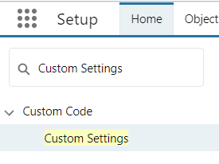
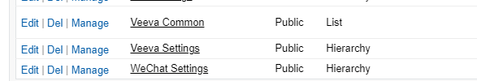
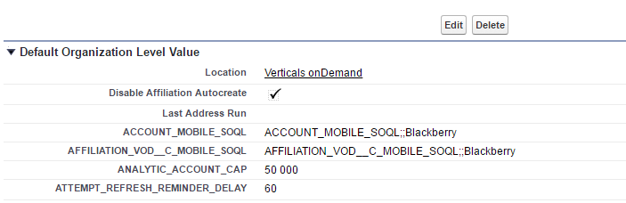
View & Modify VEEVA Settings
To view and modify VEEVA settings please follow the below steps:
Navigate to Setup → Develop → Custom Settings → VEEVA Settings
Click Manage
Depending on the customization perform in an org either just the org default VEEVA settings are displayed or both org default and profile-wise VEEVA Settings are displayed
Click ‘View’ for a Profile-wise setting in order to view the VEEVA Settings for that profile
Click Edit in order to edit the values of the VEEVA settings

Slide 9
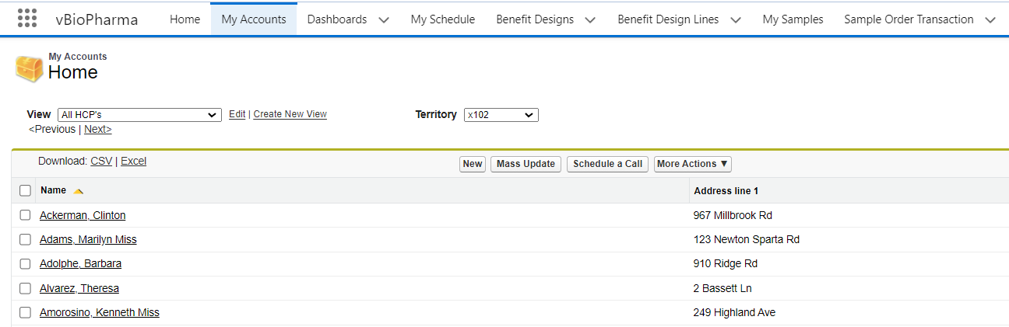
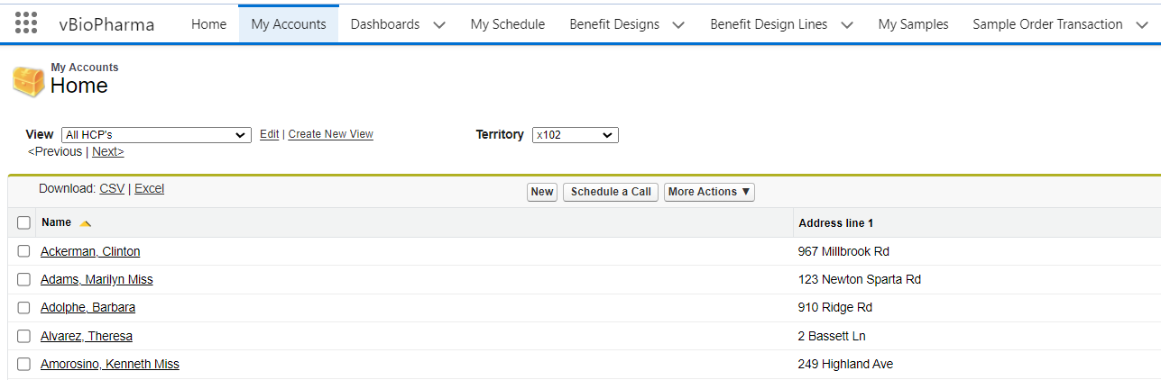
VEEVA Settings Example – My Accounts ...1
My Accounts Tab
  My Accounts tab is one of the most customized VEEVA tab
  This is a custom VEEVA User Interface runs on VEEVA servers
  This tab can bring and show data from 4 objects in a single view - Accounts, Address, Product Metrics, Territory Fields
  My accounts tab is being used to view and manage customers for end users
Example of usage VEEVA settings in My Accounts:
  To remove the Mass Update button:
  Setup → Develop → Custom Settings → VEEVA Settings → Manage → Disable Mass Update

Slide 10
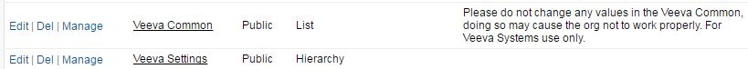
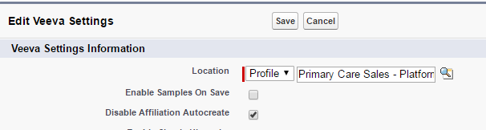

VEEVA Settings Example – My Accounts ... 2
To remove the Mass Update button for most users but leave it on for others
  Define profile specific custom settings
  Disable Mass Update custom setting for users of specific profiles
  Setup → Develop → Custom Settings → VEEVA Settings → Manage
  Scroll to the bottom of the page and click New to add profile specific VEEVA custom settings
Users of this profile will not see ‘Mass Update’ button
Disable Mass Update

Slide 11
VEEVA Settings More Examples
Disable All Accounts
  If set to True, then the All Accounts option in the territory picklist will be removed if the user is aligned to at least one territory
Enable Sample Card License Check
  If true, then users will not be able to submit calls with sample card info with an address without a valid license
Data Change Request Mode
  Determines if a user can create Data Change Requests. Default value is 0 which means Data Change Request is turned off while the value 1 means Data Change Request is Enabled
CLM Highlighter Pen
  When checked, enables the highlighter pen in CLM
Prevent TOT Overlap
  Setting for enabling warnings/errors when time off territory records overlap

Slide 12
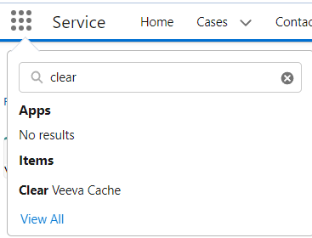
Clear VEEVA Cache
The VEEVA CRM application uses cache on the VEEVA servers for the components that are specific to the VEEVA CRM application
Cache is used to store reusable parts of the application on the server to improve response time for users
VEEVA Cache is cleared by an automated process every 16 hours. However, an administrator can manually clear the Cache
In order to manually clear cache administrator needs to do the following:

Slide 13
VEEVA Settings and VEEVA Messages
VEEVA Messages

Slide 14
What are VEEVA Messages?
VEEVA Message is a custom object which stores text and labels for all VEEVA CRM configured components, labels and error messages
The VEEVA Message object requires users to have READ permission to the VEEVA Message object and all its fields. Administrators need to have with Edit access to the VEEVA Message object
Along with text and labels, VEEVA Messages also consist of some settings information which are referred by VEEVA CRM functionalities in order to change the behavior of some VEEVA components
  For example, ALLOWED_CALL_RECORD_TYPES VEEVA Message is used to govern Allowed call record types by account record types

Slide 15
VEEVA Settings and VEEVA Messages
Fields in a VEEVA Message Record

Slide 16
Fields in a VEEVA Message Record ... 1
The main fields in a VEEVA Message record are:
Message Name
  This is the name which is referenced in VEEVA code to display a text/label or to alter functionality of a module
Description
  A VEEVA provided Description of the VEEVA Message
Type
  Displays what type of VEEVA Message the record is. Some of the types are Label, Custom Settings, VEEVA and Config
Category
  Denotes a grouping of messages in the catalog

Slide 17
Fields in a VEEVA Message Record ... 2
The main fields in a VEEVA Message record are:
Active
  Used to mark a VEEVA Message as Active. Only active messages are retrieved by VoD
Language
  The message catalog provides a way to store messages for different languages. This field is used to denote the language for which the VEEVA Message record is applicable
Text
  This field stores the actual text/label which is displayed in the application

Slide 18
VEEVA Settings and VEEVA Messages
Creation of Custom VEEVA Message

Slide 19
Create Custom VEEVA Message ...1
Administrators need to have with Edit access to the VEEVA Message object
However, an original VEEVA Message should not be changed
If changed it will be overwritten when your VEEVA application is upgraded to a new version
In case a VEEVA Message need to be modified please perform the below steps:
  Inactivate the original VEEVA Message
  Clone the VEEVA Message inactivated in 1st step
  Activate the new custom VEEVA Message
  Provide custom Text in the VEEVA Message
  Modify the External ID since it is unique
  Save the record
  Perform Clear VEEVA Cache
Please do not change the value of any other field in VEEVA Message record except the ones mentioned above since the VEEVA Message may not work if any field value is modified

Slide 20
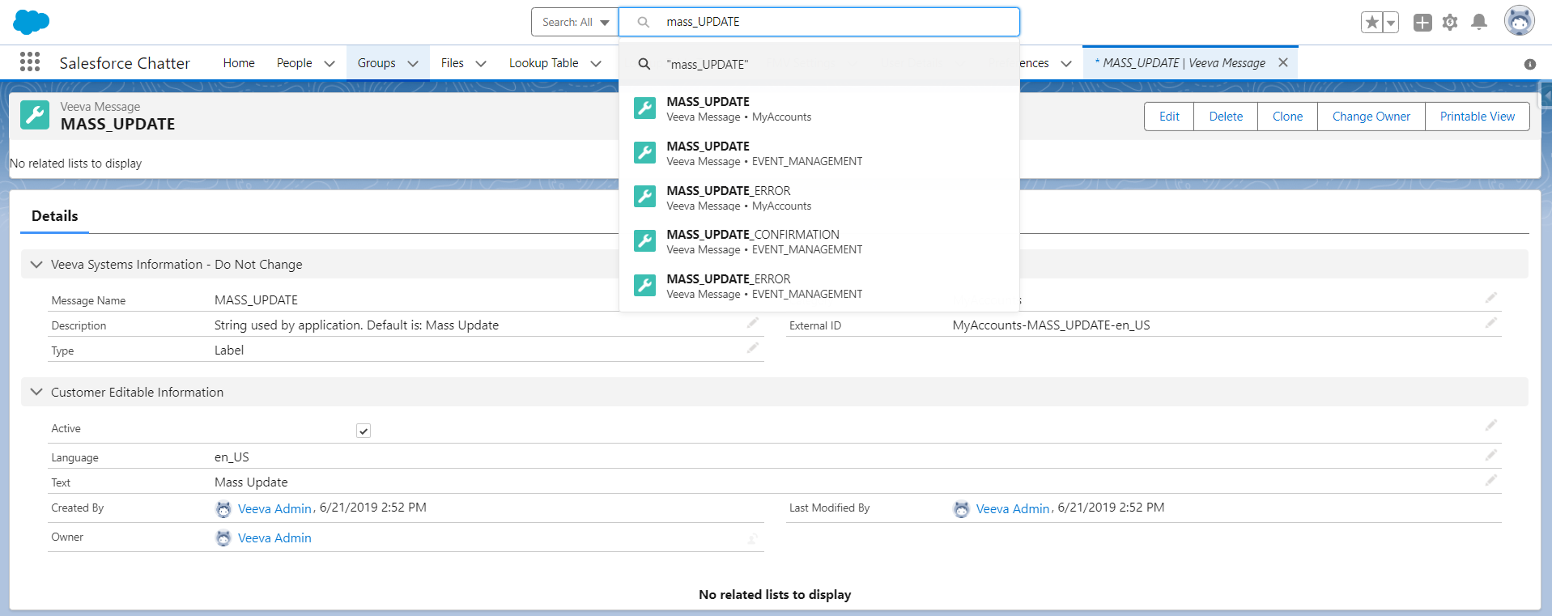
Create Custom VEEVA Message ... 2
VEEVA admin wants to change the ‘Mass Update’ button text to ‘Mass Account Update’ to meet the requirement
He will have to perform the following:
  Search for ‘Mass Update’
  Click on the ‘Edit’ button
  Admin can also go to ‘All Tabs’ → VoD Messages and then go for specific VEEVA Messages

Slide 21
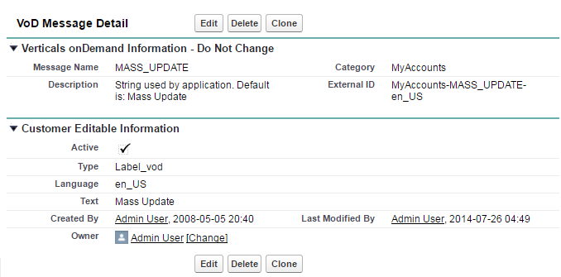
Create Custom VEEVA Message ... 3
Change on the original VEEVA Message
2. Clone the VEEVA Message
1. Inactivate the original VEEVA Message

Slide 22
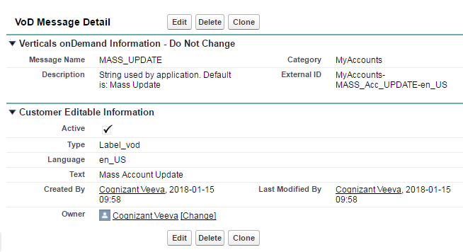
Create Custom VEEVA Message ... 4
Change on the newly created cloned VEEVA Message
Do not change the Message Name, as this is being referenced be the code
Activate the new custom VEEVA Message
Provide custom Text in the VEEVA Message
Modify the External ID since it is unique

Slide 23
VEEVA Settings and VEEVA Messages
VEEVA Message and Best Practices

Slide 24
VEEVA Message – Best Practices
It is advisable to follow the below best practices while configuring VEEVA Messages:
Export VEEVA Message using Data Loader into Excel since it is easier to sort and search in Excel
Create custom views on VEEVA Messages tab with custom filters such as filter on Category and/or Type
Add a comments field to VEEVA Messages object in order to capture configuration comments while modifying a custom VEEVA Message
For creating new VEEVA message always clone an existing one
An original VEEVA Message should not be changed. If changed it will be overwritten when your VEEVA application is upgraded to a new version

Slide 25
VEEVA Messages Examples
ACCESS_ERROR
  This is a string used in application to display the message “You do not have the level of access necessary to perform the operation you requested”
MISSING_FIELDS
  VEEVA Message used to display the error message “You must fill out all of the fields”
ALLOWED_CALL_RECORD_TYPES
  This message stores a list of allowed call record types by account record type
  Using this message admin can define which Call record types will be application for a particular account record type
  If there is no call record type provided, the call functionality will be removed for that account record type
DISABLE_RM_QUERY
  This VEEVA Message is a configurable parameter to prevent a My Account view from executing for a territory with too many levels

Slide 26
VEEVA Settings vs VEEVA Messages
VEEVA Settings
VEEVA settings is used to change behavior, enable or disable any functionality
Example: remove a button from UI
VEEVA Message
VEEVA message is used to change the text shown on UI
Example: change the button text, error message, field label

Slide 27
VEEVA Settings and VEEVA Messages
VEEVA Marker Fields and Best Practices

Slide 28
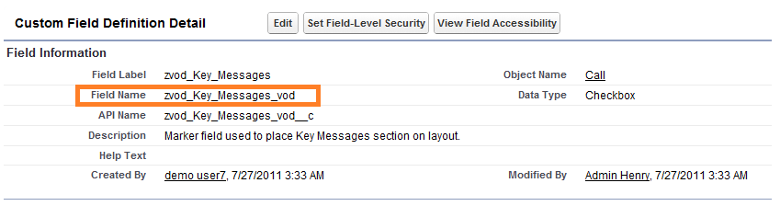
VEEVA Marker Fields
Contain special code that renders a custom piece of user interface
  Stores no data, only add functionality to page layouts
Mainly used on layouts for Call Reporting, Medical Inquiries, and other objects
Denoted with the prefix “zvod_” and the suffix “_vod”
Don’t:
Delete Marker Fields
Edit the name or data type fields
Admin can only:
Add or remove Marker fields from page layouts

Slide 29
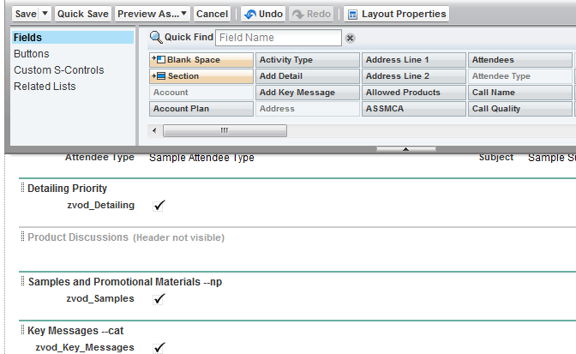

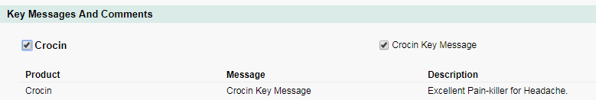
VEEVA Marker Fields Example
Identify the call page layout to be modified
To edit a call page layout:
  Setup > Create > Objects > Call > Page Layouts section
  Click the Edit link for the desired page layout
Create 1-column sections.
Place Marker fields in their respective section, then only those sections or functionalities will appear
Use Section Signals to change the behavior of the Marker field

Slide 30
VEEVA Marker Fields – Best Practices
VEEVA admin always need to follow the best practices:
  Do not delete the VEEVA Marker fields, as they are being used by VEEVA code
  Do not modify the VEEVA Marker fields like name or data type, as they are being used by VEEVA code
  If needed, only remove the fields from page layouts

Slide 31
VEEVAtization
When any VEEVA developer sandbox is refreshed, Salesforce does not automatically copy the custom objects from production to developer sandbox
Hence this is the duty of the admin to load the following explicitly after the VEEVA sandbox is refreshed:
  VEEVA Messages
  Views: This object stores information about views like my accounts view etc.
  VEEVA Mobile Object Configurations: The VMobile Object Configuration object controls what objects and records are sent to the VMobile Tablet. The data is entered on the VMobile Object Configuration tab.

Slide 32
VEEVA Configuration – Best Practices
VEEVA admin always need to follow the best practices:
  Other than label, do not modify anything with “_vod” in the name or API
  Never use the “_vod” when creating or modifying customer specific objects
  It is recommended to not rename VEEVA Tabs
  Clear the VEEVA Cache after all configurations changes

Slide 33
Check Your Understanding ... 1
1. VEEVA Settings does not support settings at which level?
Organization
User
Profile
None of the above
Answer: User

Slide 34
Check Your Understanding ... 1
2. It is advisable to Clear VEEVA Cache after modifying VEEVA Settings.
State True or False
True
False
Answer: True

Slide 35
Check Your Understanding ... 1
3. Which of the following is a valid VEEVA Settings?
Disable All Accounts
Enable Sample Card License Check
Disable First Name Required
All of the above
Answer: All of the above

Slide 36
Check Your Understanding ... 1
4. Which of the below is not a best practice while configuring VEEVA Messages?
Export VEEVA Messages into Excel
Modify original VEEVA Messages
Custom views on VEEVA Messages tab
Add comments field in VEEVA Messages object
Answer: Modify original VEEVA Messages

Slide 37
Check Your Understanding ... 1
5. _____ VEEVA Message is used to govern Allowed call record types by account record types.
ALLOW_CALL_RECORD_TYPES
ALLOWED_CALL_RECORD_TYPES
ALLOWED_CALL_RECORD
ALLOW_CALL_RECORD
Answer: ALLOWED_CALL_RECORD_TYPES

Slide 38

Summary
In this module, you have learnt to:
  Describe how VEEVA Settings are used
  Describe various fields of a VEEVA Message Record
  Create a custom VEEVA Message
  Identify the uses and best practices for VEEVA Marker Fields

Slide 39
Thank you
  You have successfully completed
  VEEVA Settings and VEEVA Messages

